Slide 1
Chapter 12
Testing Hypothesis

Slide 2
Outline
Student Learning Objectives
The Theory of Hypothesis Testing
Testing Hypothesis on Expectation
Testing Hypothesis on Proportion
Summary
Self-Quiz Unit 4 Review
Assignment Unit 4 Guide

Slide 3
Student Learning Objectives
Formulate statistical hypothesis for testing.
Test, based on a sample, hypotheses regarding the expectation of the measurement and the probability of an event.
Identify the limitations of statistical hypothesis testing and the danger of misinterpretation of the test’s conclusions.

Slide 4
The Theory of Hypothesis Testing
Statistical inference is used in order to detect and characterize meaningful phenomena that may be hidden in an environment contaminated by random noise.
The R function “t.test” is used to conduct hypothesis testing.
The first step in hypothesis testing is the formulation of the statistical model and the identification of the parmeter(s) that should be investigated. In the book, an example of statistical model correspond to the assumption that in the variable “price” are an instance of a random sample. The parameters under investigation are: the expectation and the variance of the measurement.
Once the first step is completed, the process of testing a statistical hypothesis can be broken into three steps: 1) formulation of the hypotheses, 2) specification of the test, and 3) reaching the final conclusion.

Slide 5
The Theory of Hypothesis Testing
The hypothesis formulation step and the specification step of the test can be performed before the collection of the observations. These two steps are done on the basis of the probabilistic characteristics of the statistical model and in the context of the sampling distribution.
The step of reaching the final conclusion involves the actual data and the R function “t.test”
1) Formulating the hypothesis:
This steps involve defining the null hypothesis (H_o) and the alternative hypothesis (H_1)
Formulating hypotheses emerges in response to the situation when the phenomena under investigation is absent or present. It is then important to clearly identify or define the phenomena under investigation.
The null hypothesis (H_o) represents the parameter values where the phenomena is absent.
The alternative hypothesis (H_1) represents the parameter values where the phenomena is present.

Slide 6
The Theory of Hypothesis Testing
1) Formulating the hypotheses:
It is also important to note that a variation in the formulation of the phenomena can change the definition of th null and alternative hypotheses
A two-sided alternative is when the alternative hypothesis (H_1) is not an inequality
A one-sided alternatives is when the alternative hypothesis (H_0) is an inequality
The formulation of the hypothesis is a reflection of the phenomena one wishes to examine.
The setting associated with the presence of the phenomena is denoted the alternative hypothesis and the complimentary setting, the setting where the phenomena is absent, is denoted the null hypothesis

Slide 7
The Theory of Hypothesis Testing
2) Specifying the test:
This step involves the selection of the decision rule (or the statistical test) to be used in order to be used to decide between the two hypotheses.
The decision rule is composed of a statistic (also called test statistic) and a subset of values of the statistic that correspond to the rejection of the null hypothesis (also called rejection region).
The decision is to reject the null hypothesis (and consequently choose the alternative hypothesis) if the test statistic falls in the rejection region. Otherwise, if the test statistic does not fall in the rejection region then the null hypothesis is selected.
The test statistic measures the discrepancy between the estimated value of the estimator and the expected value under the null hypothesis. This discrepancy is measured in units of the (estimated) standard error.

Slide 8
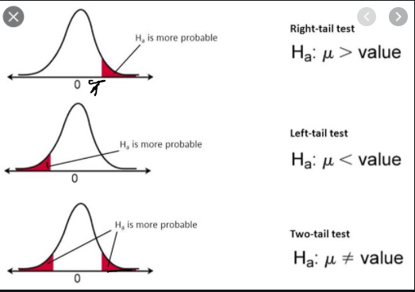
The Theory of Hypothesis Testing
2) Specifying the test:
https://youtu.be/9tpJEZnx9zU
https://youtu.be/trOdkviqLkw
https://youtu.be/ZZKNRbrz3Jw
The area in red under the curve is the rejection area
The area in while under the curve is where we fail to reject the null hypothesis.

Slide 9
The Theory of Hypothesis Testing
3) Reaching a conclusion:
At this step, we compute the observed value of the test statistic and check whether or not the observed value belongs to the rejection region.
If it does belong to the rejection region then the decision is to reject the null hypothesis.
Otherwise, if the statistic does not belong to the rejection region, then the decision is to accept the null hypothesis (actually it is best to say we fail to reject the null hypothesis).

Slide 10
The Theory of Hypothesis Testing
Error Types and Error Probabilities:
There are two types of errors that can be encountered when conducting a Hypothesis testing.
A Type 1 Error is rejecting the null hypothesis when H0 is actually true.
A Type 2 Error is failing to reject the null hypothesis when the alternative is actually true.
Type 1 Error is more severe that Type 2 Error. The Type 1 Error is also known as the significance level. The significance level can be 5% or 1%, with 5% being the most widely used level. If you recall in the previous slide, the area in red under the curve was the rejection area. That area represent the significance level. If we incorrectly reject the null hypothesis, that is the T statistics falls under the red area, this will occurs with a probability of 5% (assuming the significance level was set at 5%).

Slide 11
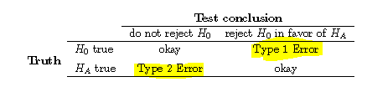
The Theory of Hypothesis Testing
Error Types and Error Probabilities:
The best way to express Type 2 errors is in term of its complement (1- Probability of Type 2 Error), which is the probability of rejecting the null hypothesis when the alternative hypothesis is true.

Slide 12
The Theory of Hypothesis Testing
p-Values:
The p-value is another test statistic.
It is the significance level of the test in which the observed value of the statistic serves as the threshold.
The p-value is used as a test statistic by comparing its value to the predefined significance level.
Remember, the predefined significance level is the red area under the curve shown previously. It is the rejection area of the null hypothesis. If the p-value is less than this area, we will reject the null hypothesis. If the p-value is greater than the red area, we will fail to reject the null hypothesis.
If the significance level is 1% then the null hypothesis is rejected for p-values less that 0.01. Likewise, if the significance level is set at the 5% level then the null hypothesis is rejected for p-values less than 0.05.

Slide 13
Testing Hypothesis on Expectation
Read page 211 to 218 and let me know if you have any questions

Slide 14
Testing Hypothesis on Proportion
It is important to the that for the case of Proportion, the test statistic is the square of the Z statistic (see the detail in the book). The sampling distribution of this statistic under the null hypothesis is, approximately, the chi-square distribution. The R function prop.test will automatically compute that statistic for us.
https://online.stat.psu.edu/statprogram/reviews/statistical-concepts/proportions
https://www.youtube.com/watch?v=5LFhu0vGzkI

Slide 15
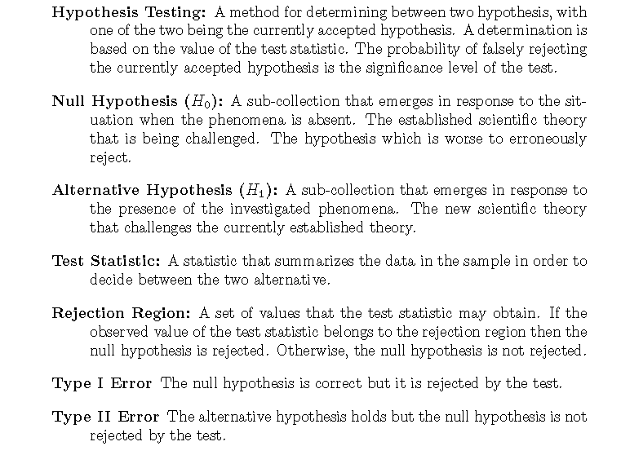
Summary

Slide 16
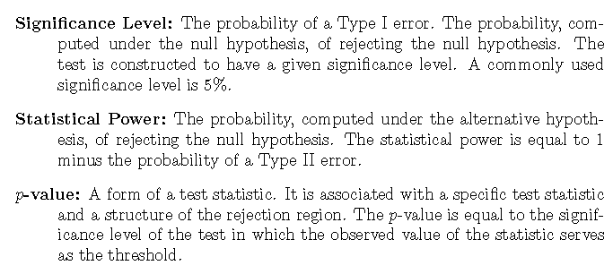
Summary

Slide 17
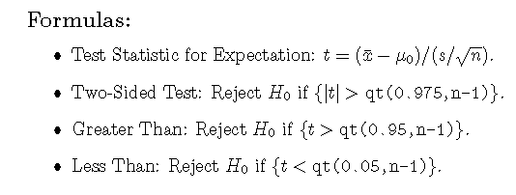
Summary

Slide 18
Self-Quiz Unit 4 Review
data<-read.csv('http://pluto.huji.ac.il/~msby/StatThink/Datasets/cars.csv')
## https://youtu.be/K31BtEO5kiw
### https://youtu.be/_Yd4oUxCH-Q
## https://youtu.be/5RJcbaBWO1A

Slide 19
Assignment Unit 4 Guide
# https://youtu.be/NtPCgrcUi10
# https://youtu.be/S-nqkRcfA1k

Slide 20
Assignment Unit 4 Guide
************************** Below is the structure of the simulation you are asked to run in question # 7
abs.diff.means<-rep(0,10^5)
for(i in 1:10^5){
x<-sample(x)
abs.diff.means[i]<-abs(mean(x[1:10])-mean(x[11:20]))
}
mean(abs.diff.means>m)

